Slide 1
Microsoft Hackathon 2022
This ppt represent the idea of hackathon and also have the design idea of project represented by
anshit mishra

Slide 2
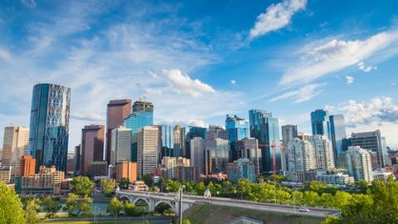
Problem statement-
Smart City

Slide 3
SMART CITY MAJOR OBJECTS
Clean street.
Water supply
Proper roads
Security for girl’s/women’s
Better complain system

Slide 4

HOW WE WILL ACHIEVE THIS OBJECTS ??

Slide 5
OUR IDEA IS BASED ON SIMPLE METHOD
We will create a app that can solve these problems even it can solve many other problems.
App description -: our app will CONNECT GOVERNMENT OFFICE DIRECT TO LOCAL PEOPLE.
(*) EXAMPLE CASE -: Suppose In your street there is pipe leak and you are normal it working men/women most probably you will ignore that problem according to survey 65% problems in INDIA are not registered just because it take to much time and efforts to complain in government office and even you you do complain the whole process of solving problem will take number of days.
With this idea we can solve this problem and reduce number of days to number of hours and this is just a single example this idea have much more potential

Slide 6
How this idea can achieve major point of smart city
WE will just connect people with government and government will do rest like -:
Government already run to many facility but just because of lack of information. To make city smart loca people must have CONNECTIVITY WITH GOVT OFFICE IN THEIR HANDS.
APP FLOW AND APP DESIGN IS UNDER PROCESS.

